Slide 1
Calculating Speed
Speed = Distance divided by time

Slide 2
Distance Divided by Time Practice
Time (s) | Distance (m)
0 | O
1 | 10
2 | 20
3 | 30
4 | 40
5 | 50
6 | 60
7 | 70
8 | 80
9 | 90
10 | 100

Slide 3
Practice together
0m/0s = 0m/s
10m/1s= 10m/s
20m/2s= 10m/s
30m/2s= 10m/s
Complete remaining time by yourself.
Answer the question: Did this object move at a constant speed or did it change speed?

Slide 4
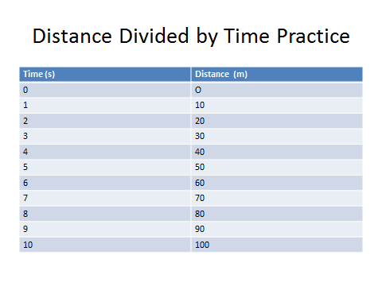
Practice

Slide 5
Answers
All answers were 10m/s
Is this constant speed or a changed speed?

Slide 6
Next Try
Time (s) | Distance (m)
0 | 0
5 | 6
10 | 12
15 | 18
20 | 24
25 | 33
30 | 40
35 | 59
40 | 70
45 | 90
50 | 100

Slide 7
answers
0m/s
6m/5s = 1.2m/s
12m/10s = 1.2m/s
18m/15s = 1.2m/s
24m/20s = 1.2 m/s
33m/25s = 1.3 m/s
40m/30s = 1.3m/s
59m/35s = 1.7 m/s
70m/40s = 1.8m/s
90m/45s = 2 m/s
100m/50s= 2 m/s
What do these results show about the speed of this object?

